Slide 1
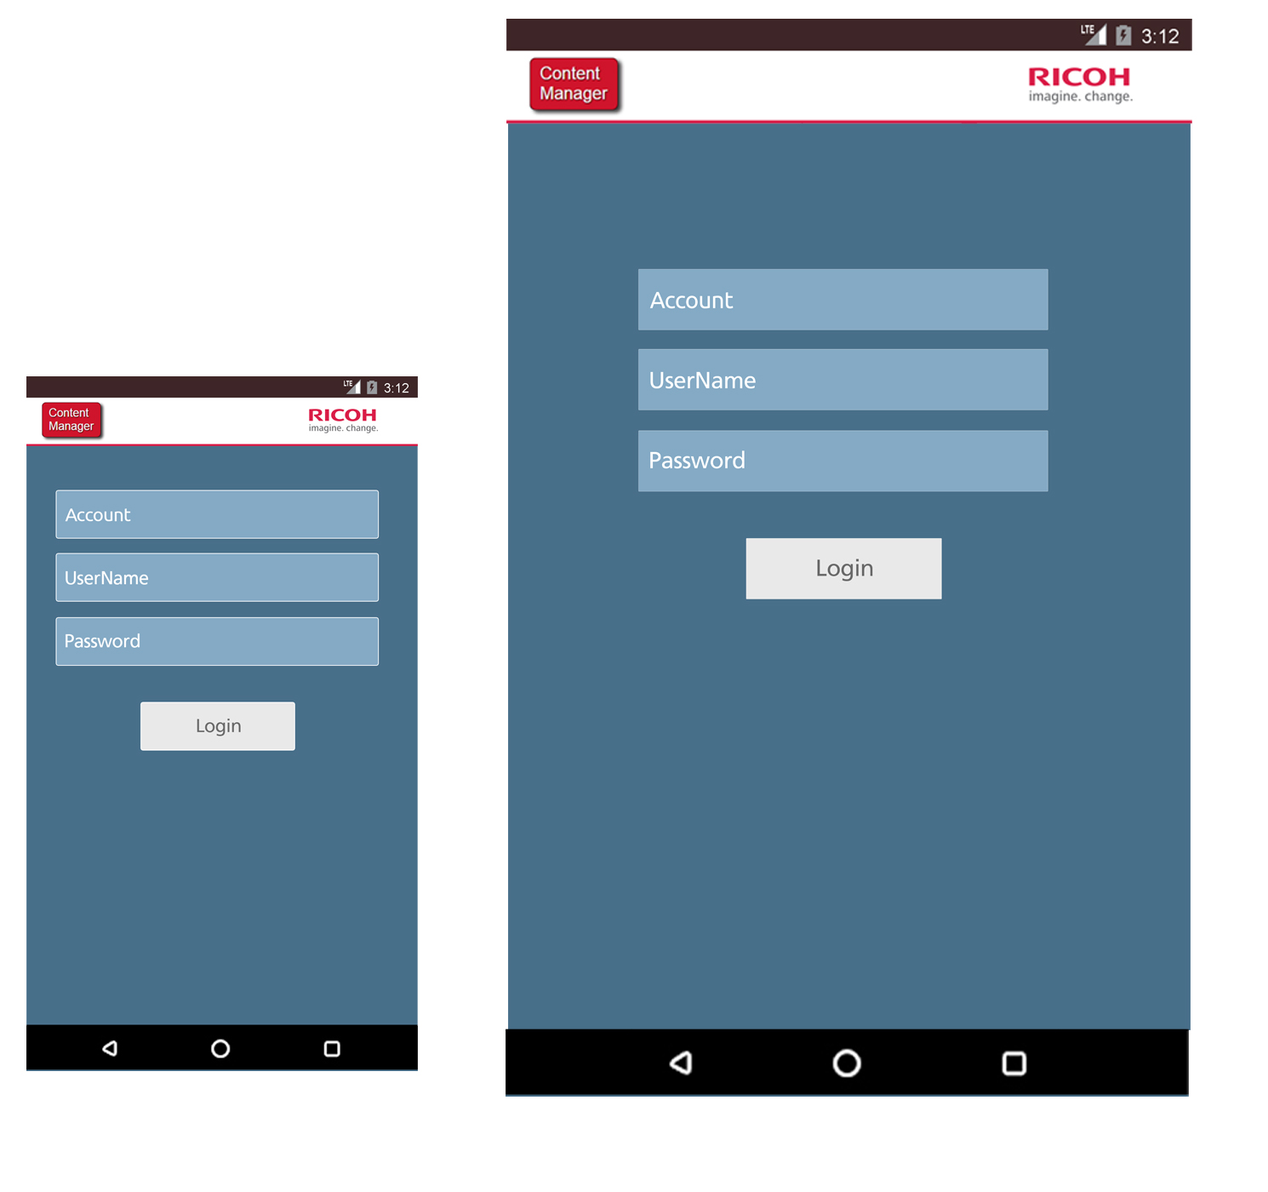
RCM – login page

Slide 2
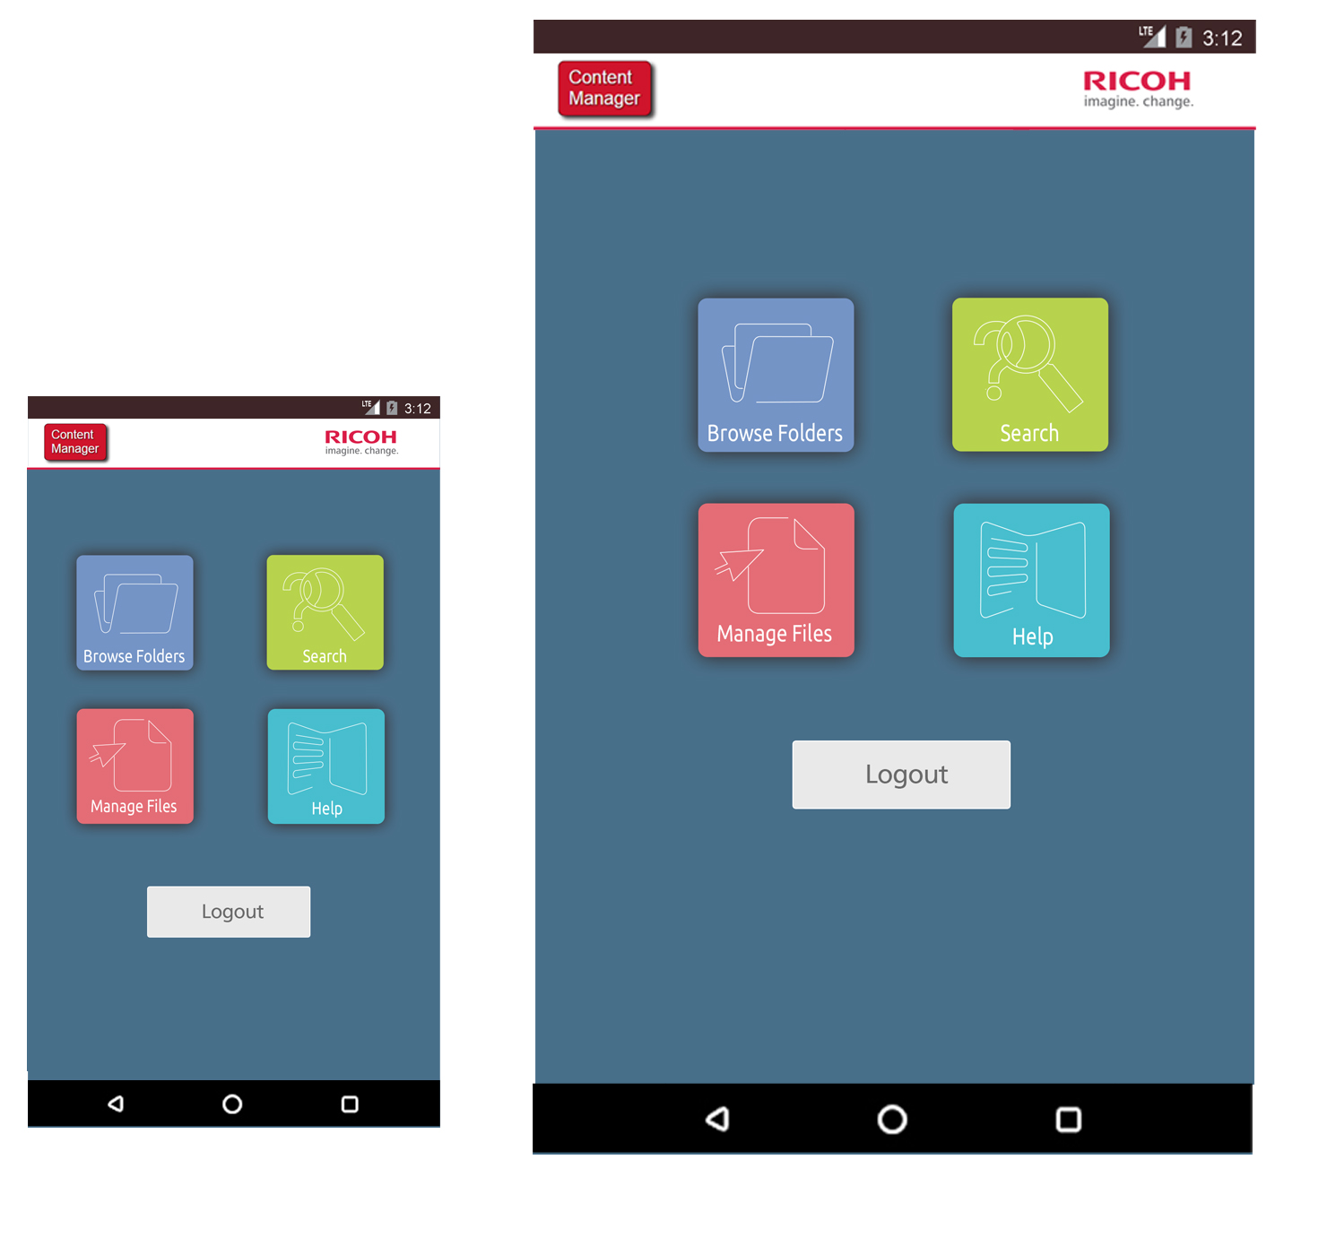
RCM – main tile page

Slide 3
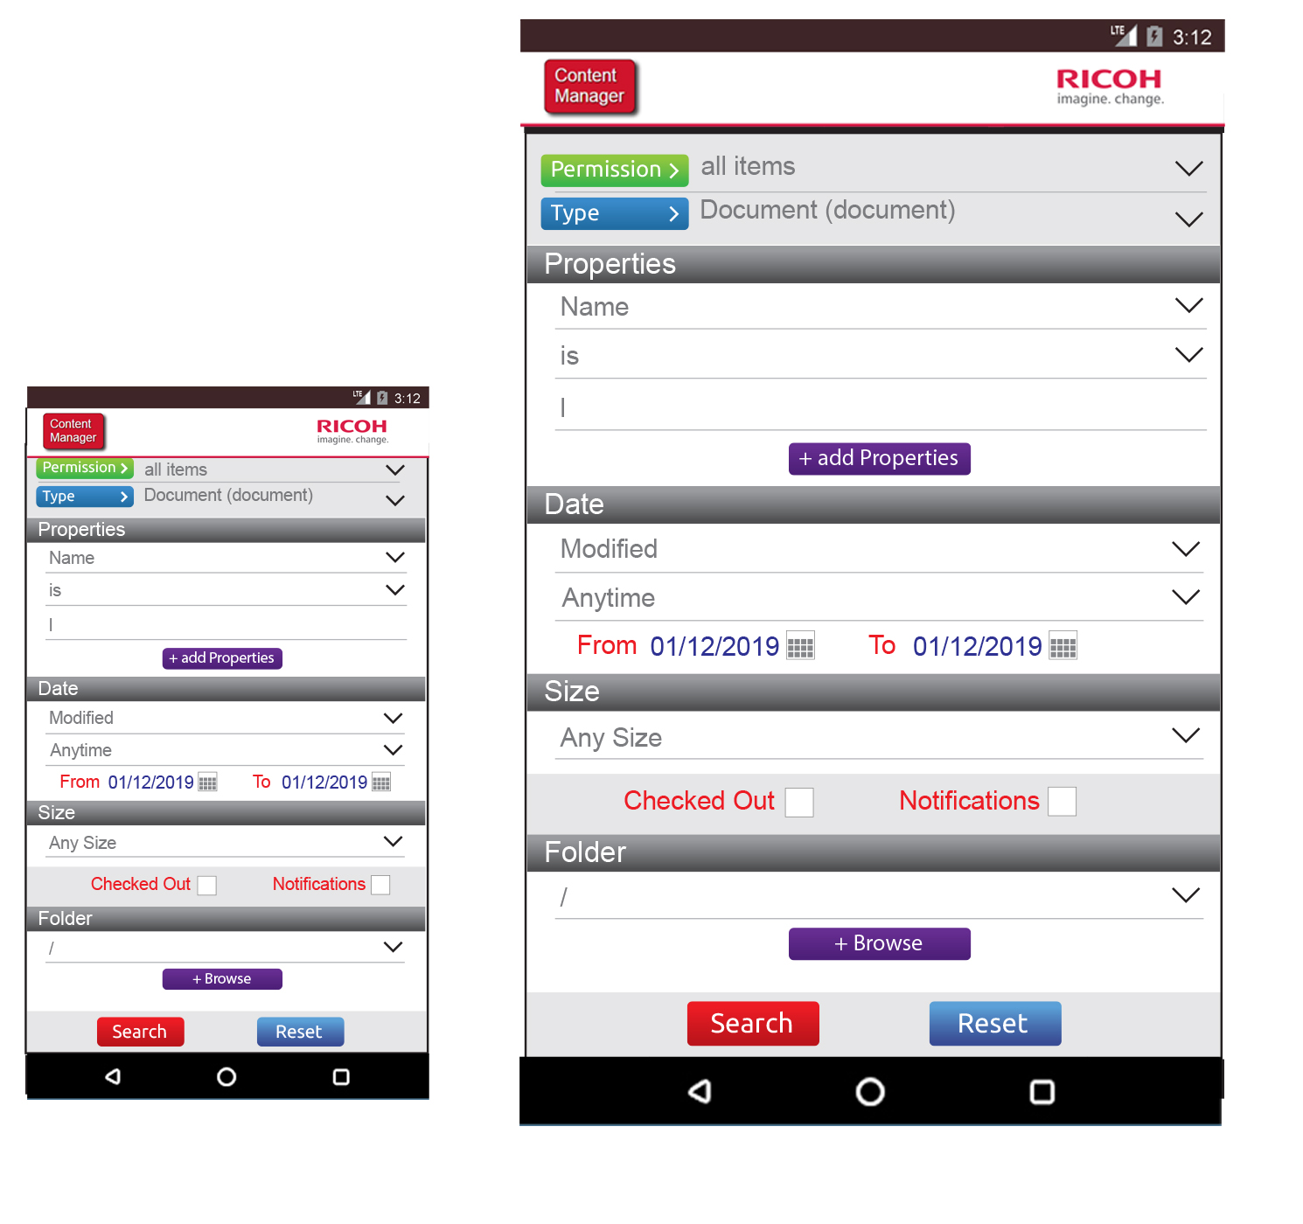
RCM – main search page

Slide 4
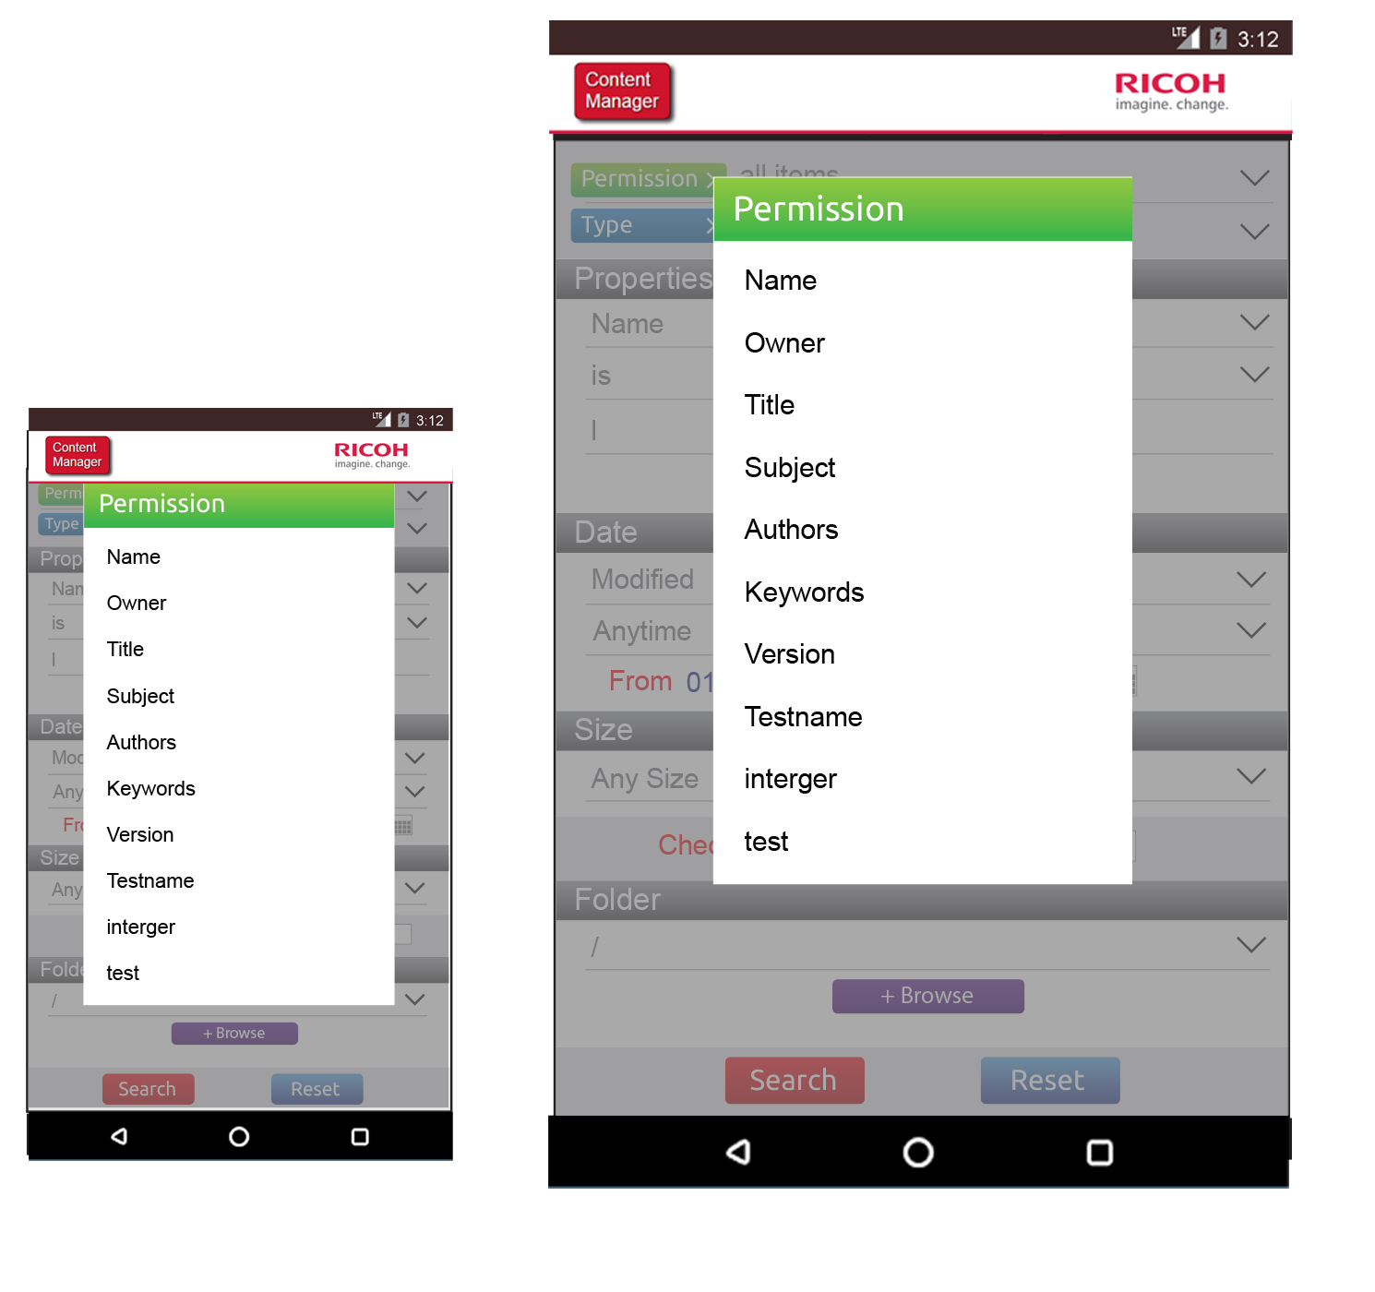
RCM – selecting permissions

Slide 5
RCM – main search page

Slide 6
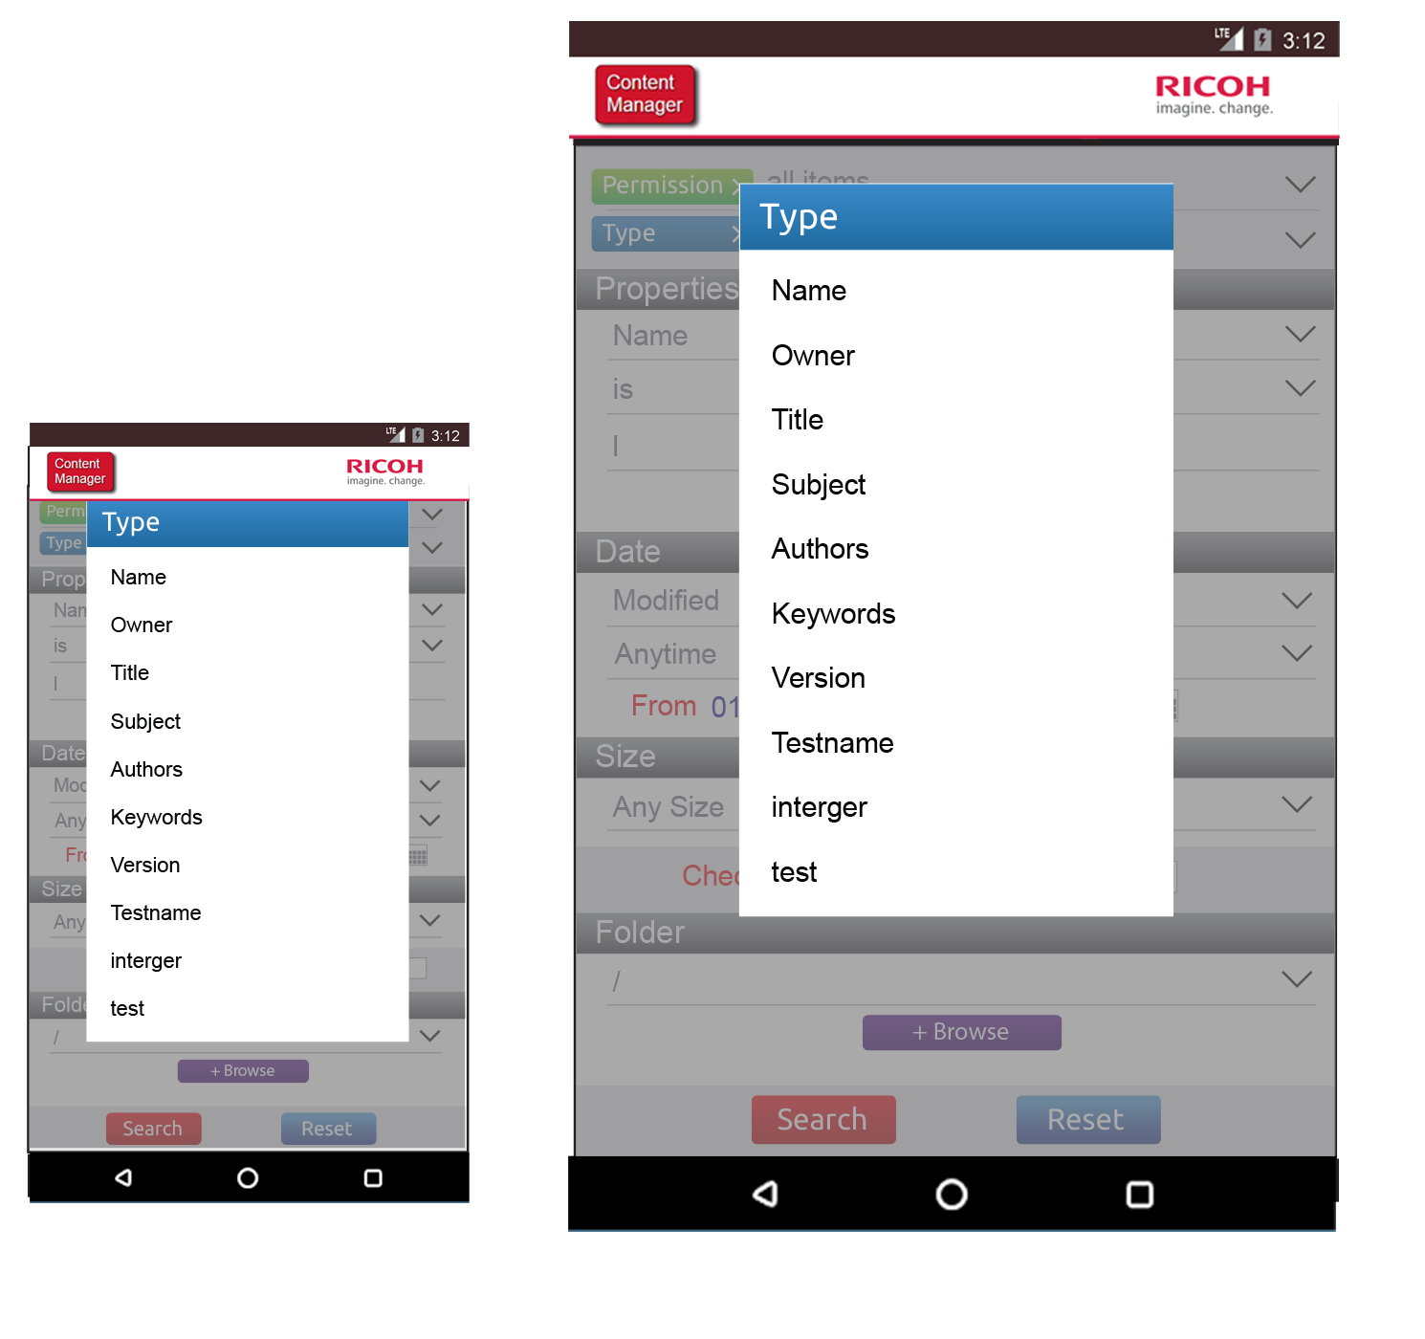
RCM – selecting type

Slide 7
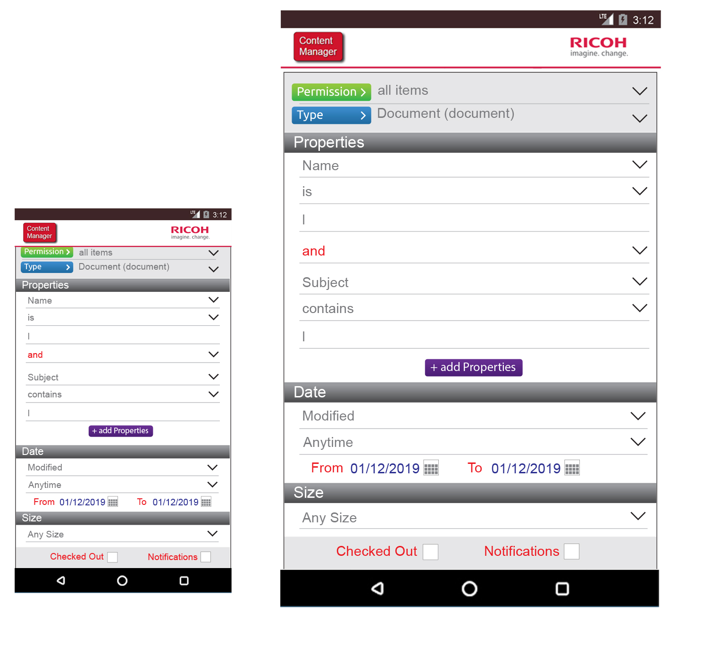
RCM – main search page

Slide 8
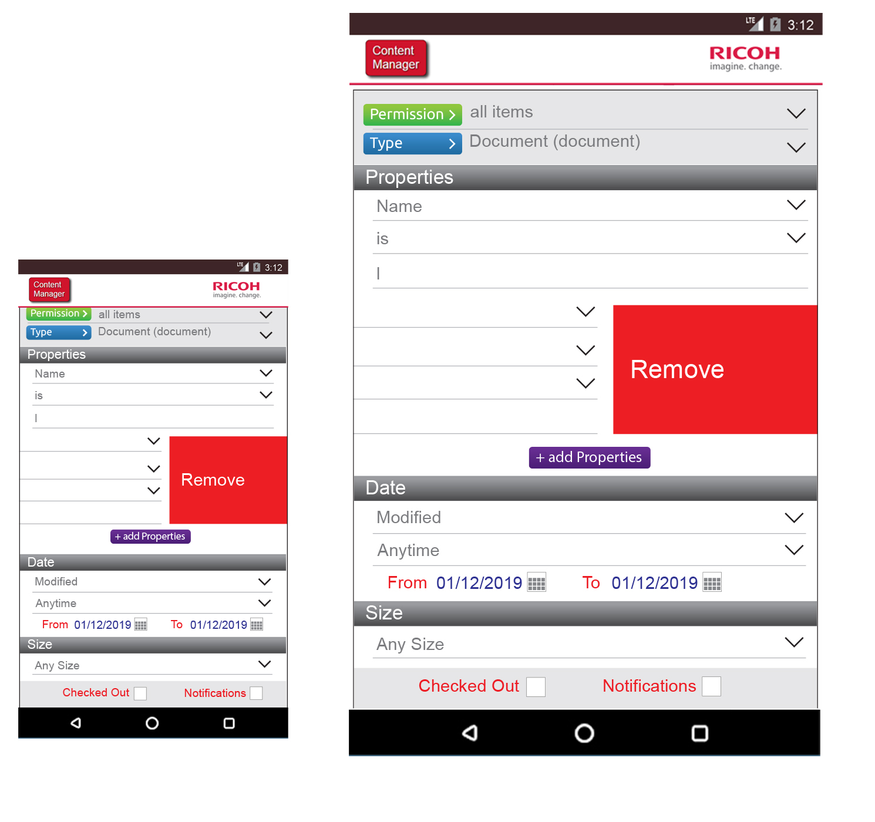
RCM – properties removal

Slide 9
RCM – main search page

Slide 10
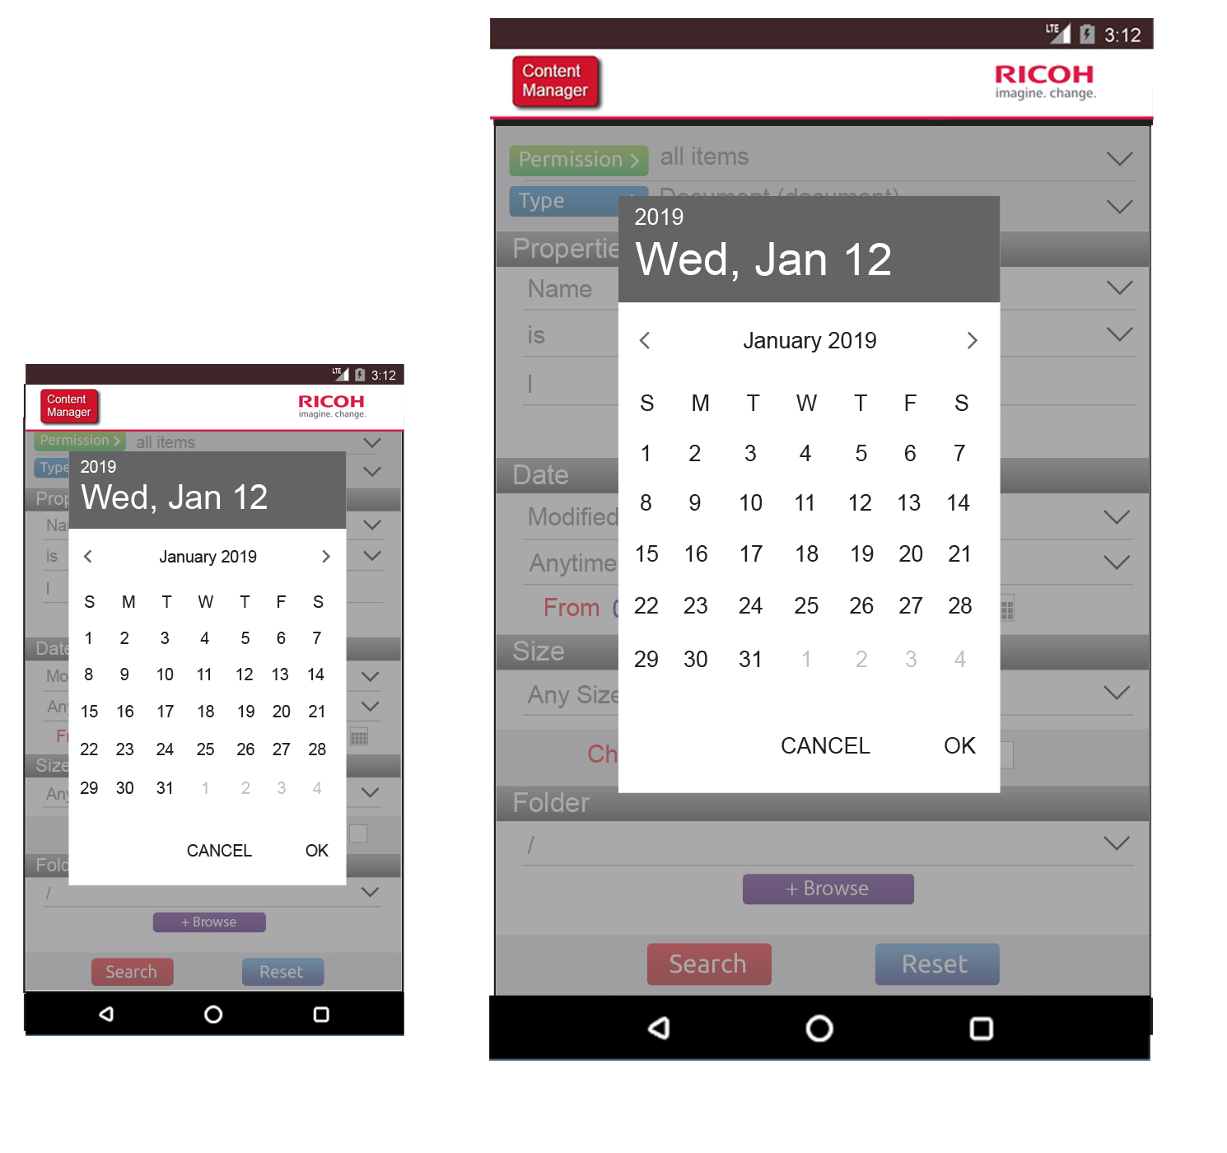
RCM – date selection

Slide 11
RCM – main search page

Slide 12
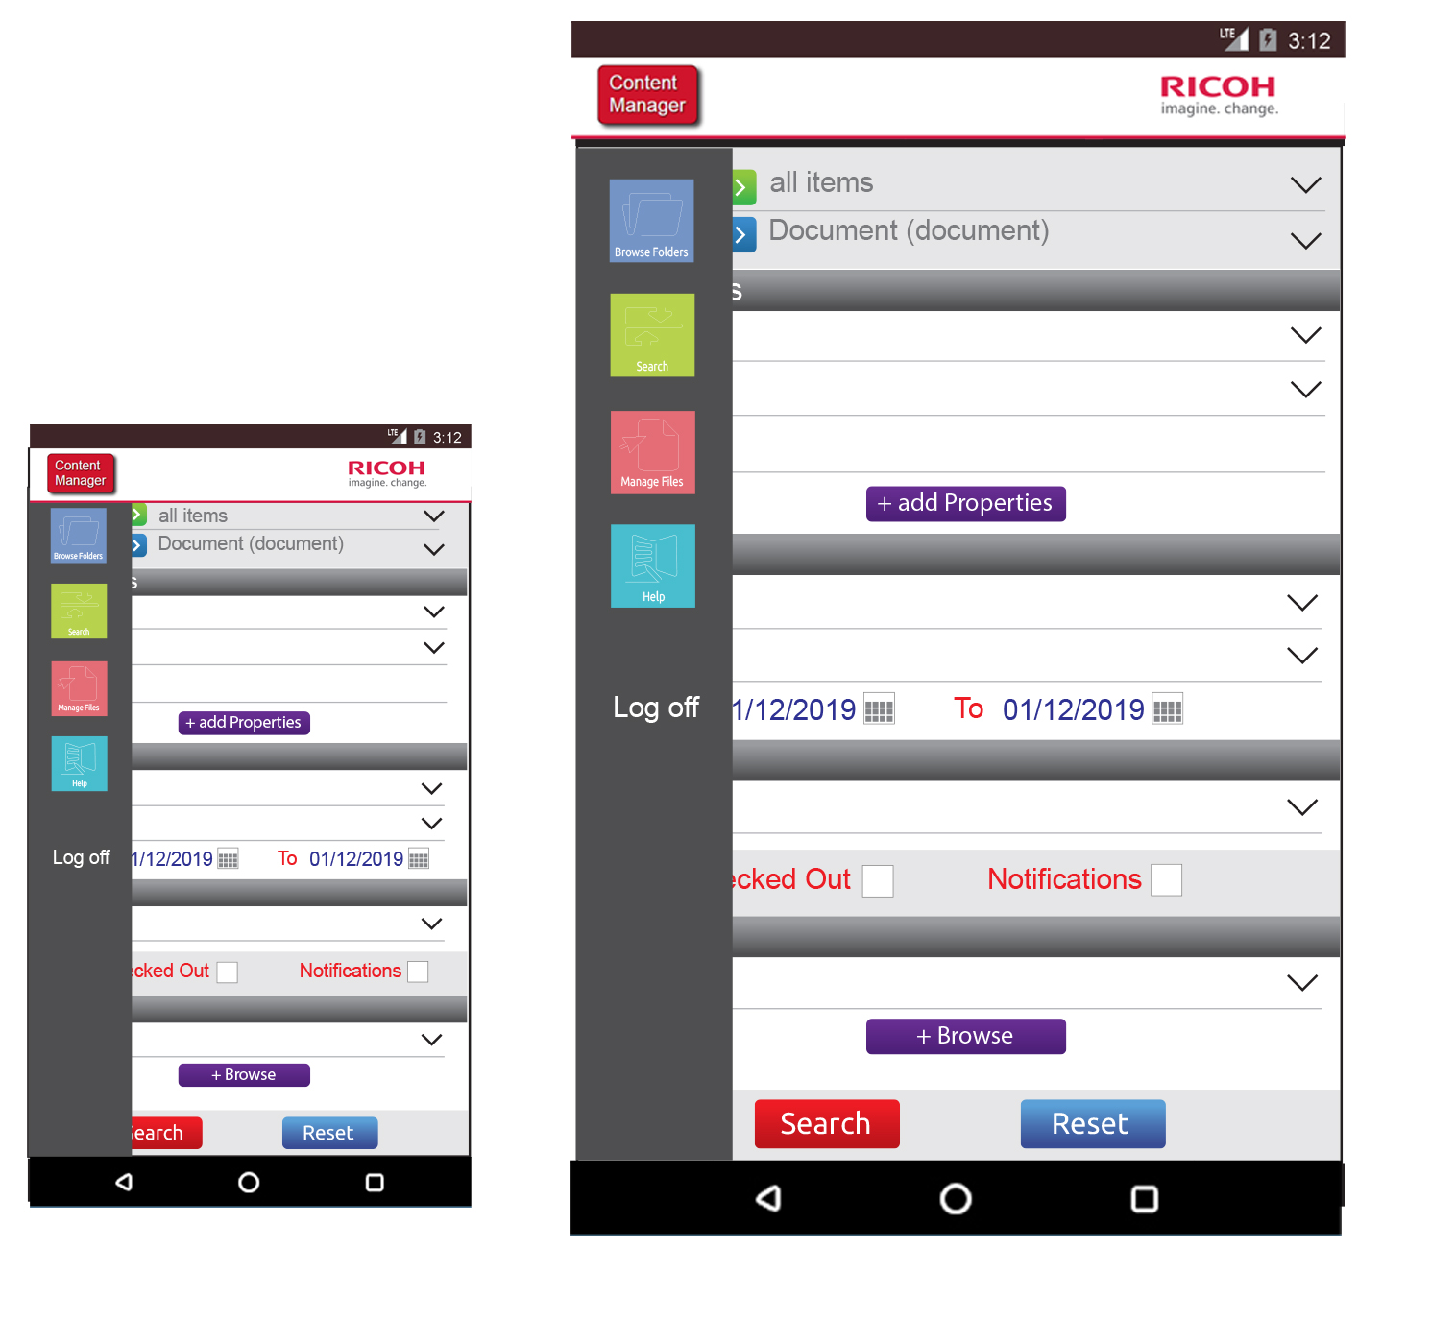
RCM – left navigation

Slide 13
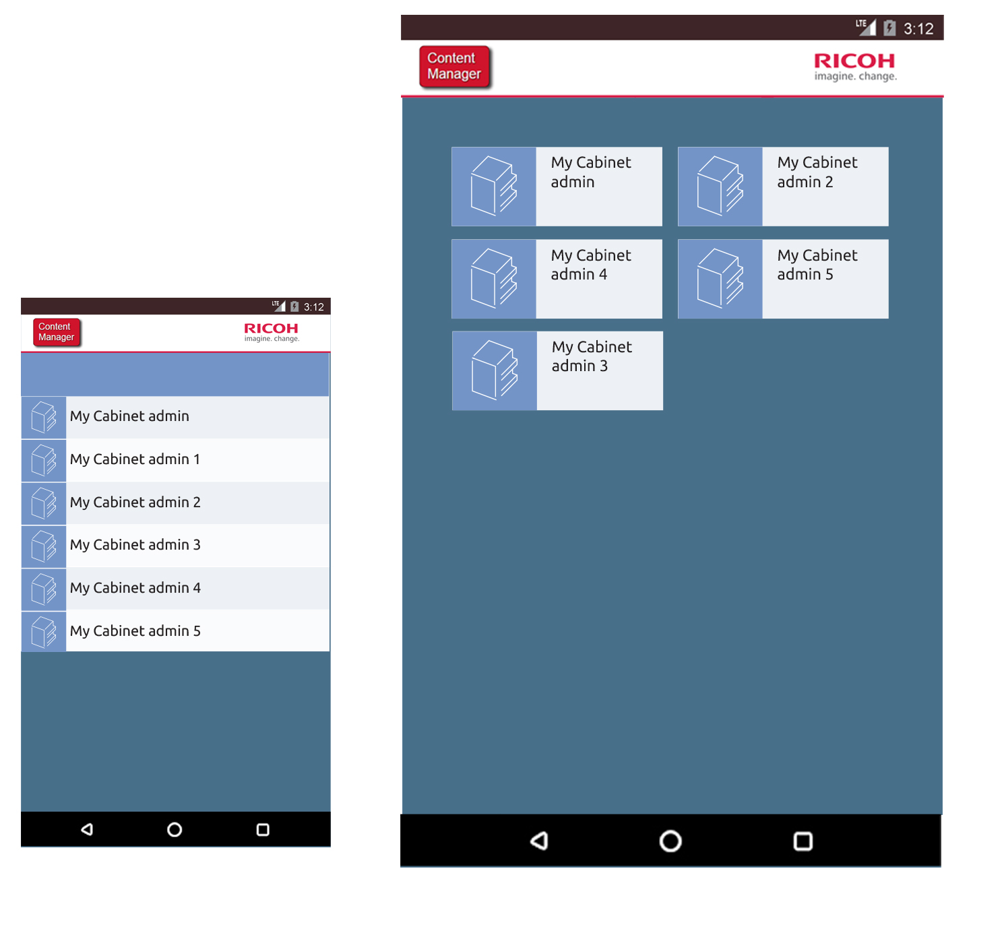
RCM – Folders

